Slide 1

Compilers Theory
Lab 2

Slide 2
Agenda
Scanner Phase: Lexical Analysis
C# Regex Class
Finite State Automata – Review
Examples on DFA
Examples on NFA
Hands-on
Appendix

Slide 3
Scanning Phase
Lexical Analysis

Slide 4
Scanning Phase: Lexical Analysis
In the Lexical Analysis Phase, the compiler reads the actual source program and collects sequences of characters into meaningful units called tokens.
Source Code
Stream of Tokens
Scanner

Slide 5
Basic Lexical Regular Expressions
Letter := [_|a-z|A-Z]
Digit := [0-9]
An identifier should start with a letter followed by any combination of letters and numbers
ID := Letter(Letter | Digit)*
An unsigned integer is any combination of unsigned numbers
Nunsigned := (digit)+
A signed integer is an unsigned integer that can be preceded by an optional sign
Nsigned := (+|-)? Nunsigned

Slide 6
Basic Lexical Regular Expressions cont.
A float Number is a signed number followed by optional dot operator and unsigned number
NFloat := Nsigned( \. Nunsigned)?
A Float Number with exponent is a float number followed by optional E and a signed number.
NFloatExp := NFloat (E NSigned)?
A Reserved word can be one of the following keywords (if, while, int, for, float, char, else or endif)
RW := if | while | int | for | float | char | else | endif
An Operator can be one of the following signs (+,-,*,/,%,<,>)
Op := + | - | * | / | % | < | >

Slide 7
C# - Regex Class
Notes:
https://docs.microsoft.com/en-us/dotnet/standard/base-types/regular-expression-language-quick-reference

Slide 8
C# - Regular Expressions
C# has built-in API for working with regular expressions; found in System.Text.RegularExpressions
The following table shows a couple of regular expression strings.
Regex | Meaning | Regex | Meaning
. | Matches any single character. | | | Alternation operator.
? | Matches the preceding element once or not at all. | {} | repetition modifier.
+ | Matches the preceding element once or more times. | [abc] | Matches a or b, or c.
* | Matches the preceding element zero or more times. | [a-c] | Range; matches a or b, or c.
^ | Matches the starting position within the string. | [^abc] | Negation, matches everything except a, or b, or c.
$ | Matches the ending position within the string. | \ | quote or special. Used to remove the special meaning. Example: \.

Slide 9
C# - Regular Expressions cont.
Regex | Meaning
\b | matches a word boundary where a word character is [a-zA-Z0-9_]
\d | matches a digit, from 0 to 9 [0-9]
\s | matches a whitespace character, that is a space, tab, newline, carriage return. [\t\n\r]
\w | matches a word character (alphanumeric or _) [0-9a-zA-Z_]
\D | matches any non-digits [^0-9]
\S | matches any non-whitespace character [^\t\n\r]
\S+ | matches several non-whitespace characters
\W | matches any non-word character [^0-9a-zA-Z_]

Slide 10
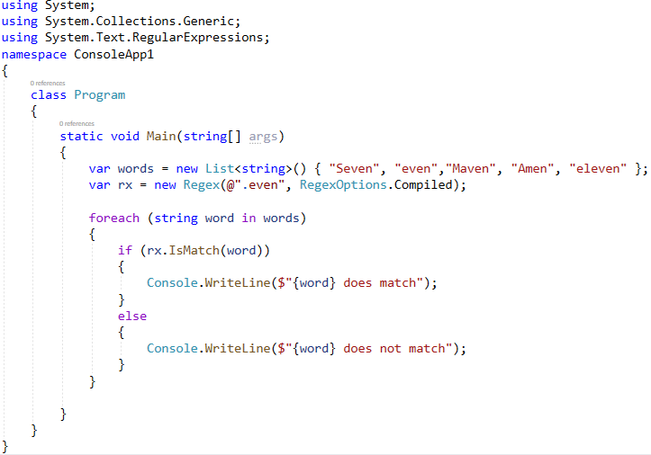
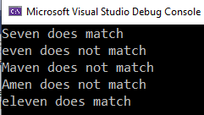
C# Regular Expression - Example
Specifies that the regular expression is compiled to an assembly
C# regex isMatch
We check which words match the .even regular expression.
Notes:
We define the .even regular expression. The RegexOptions.Compiled option specifies that the regular expression is compiled to an assembly.
This yields faster execution but increases startup time. The dot (.) metacharacter stands for any single character in the text.
Reference: https://docs.microsoft.com/en-us/dotnet/api/system.text.regularexpressions.regexoptions?view=net-5.0

Slide 11
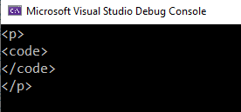
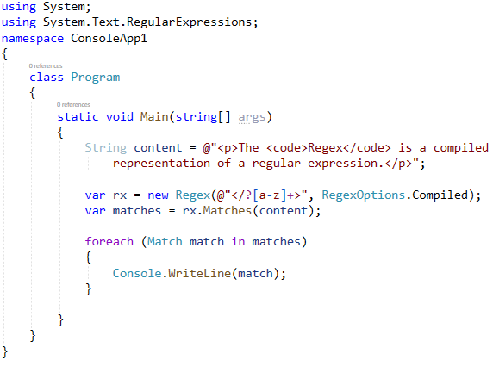
C# Regular Expression - Example
The example retrieves all HTML tags from a string.
The explicit type is MatchCollection
Represents the results from a single regular expression match.

Slide 12

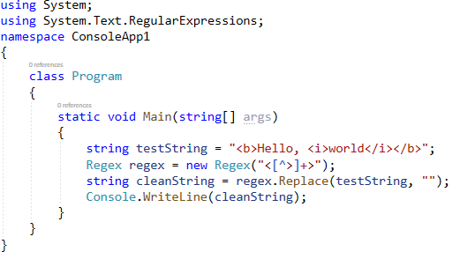
C# Regular Expression - Example
The example Replace all HTML tags from a string.
Learn more about Regex Class through the following link.
  https://docs.microsoft.com/en-us/dotnet/api/system.text.regularexpressions.regex?view=net-5.0

Slide 13
Introduction to
Finite State Automata

Slide 14
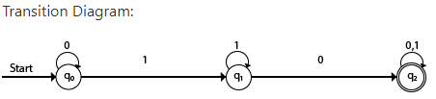
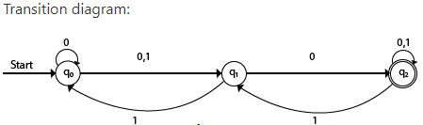
Introduction to FSA or FSM
Finite automata is a state machine that takes a string of symbols as input and changes its state accordingly.
Finite automata is a recognizer for regular expressions.
  There are two types of finite state automata
DFA (deterministic finite automata) | NFA(non-deterministic finite automata)
The finite automata are called DFA if the machine reads an input string one symbol at a time. | The finite automata are called NFA when there exist many paths for specific input from the current state to the next state.
Notes:
The main purpose of compiler is to change the code written in one language without changing the meaning of the program.
What is Finite State Machine (FSM)?
FSM are used to represent any predetermined sequence of actions.
How does it do that?
FSM consists of set of states and transitions that moves from state to state given a certain input.
https://www.cs.rochester.edu/u/nelson/courses/csc_173/fa/

Slide 15

Introduction to DFA & NFA
Example: Draw DFA and NFA with ∑ = {0, 1} accepts all strings ending with 01.
DFA:
NFA:
1
0
Do you remember the regular expression of this language?
(0|1)*01
0
1
q0
q1
q3
0
1
0,1
0
1
q0
q1
q3
Notes:
The main purpose of compiler is to change the code written in one language without changing the meaning of the program.

Slide 16
Examples on DFA

Slide 17
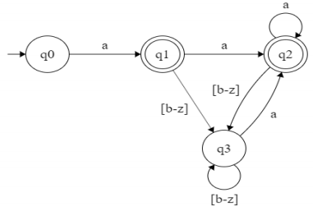
Exercises on DFA
All strings of lowercase letters that begin and end in a
RE: a[a-z]*a |a
[b-z]
Trap
[a-z]

Slide 18
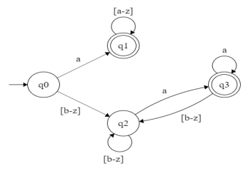
Exercises on DFA cont.
All strings of lowercase letters that either begin or end in a (or both)
RE: a[a-z]* | [a-z]*a

Slide 19
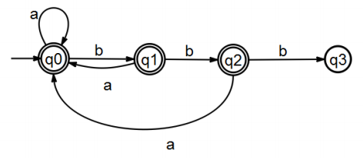
Exercises on DFA cont.
All strings of a’s and b’s that contain no three consecutive b’s
RE: (a|ba|bba)*(b|bb)?
a,b

Slide 20
Examples on NFA

Slide 21
Exercises on NFA
RE: (a|b)* ac
a, b
q0
a
q1
c
q2

Slide 22
Exercises on NFA cont.
RE: a(bab)* | a(ba)*
q2
b
a
q1
q3
b
a
q0
b
a
q4
q5
a

Slide 23
Exercises on NFA cont.
RE: == | !=
q1
=
q2
=
q3
Ɛ
q0
Ɛ
q4
!
q2
=
q6

Slide 24
Exercises on NFA cont.
RE: a (b|c)*
Ɛ
q2
q4
q2
Ɛ
b
q0
a
q1
Ɛ
q3
c
q5
q3
Ɛ

Slide 25
Extra Exercise on NFA
RE: (0|1)* (00 | 11)
q2
0
0
0, 1
q0
q3
1
1
q1

Slide 26
Hands-on

Slide 27
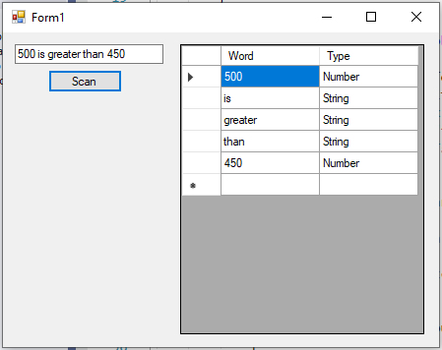
Hands-on
Create a windows form applications which has:
  Text box.
  Data grid view
  Button
Create 2 regular expressions to identify:
  Strings
  Numbers/Integers
Display the output as shown in the figure
Time limit: 15 Mins

Slide 28
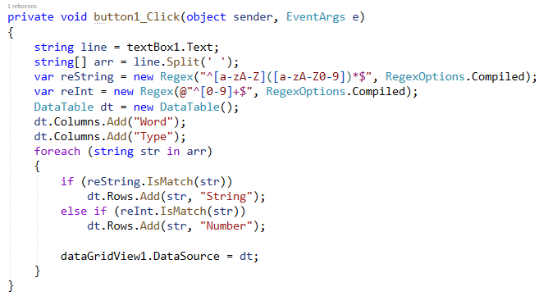
Hands-on (Solution)

Slide 29
Questions?

Slide 30
Appendix
Self-study

Slide 31

Extra Exercise on DFA
All strings of digits that contain no leading zeros
RE: [1-9][0-9]*
[0-9]
Trap
0

Slide 32
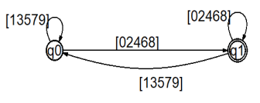
Extra Exercise on DFA
All strings of digits that represent even numbers
RE: [0-9]*[0|2|4|6|8]

Slide 33
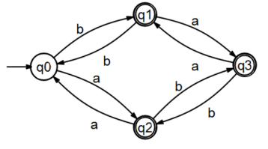
Extra Exercise on DFA
All strings of a’s and b’s that contain an odd number of a’s or an odd number of b’s
(or both)
RE: b*ab*(ab*ab*)* | a*ba*(ba*ba*)*

Slide 34
Extra Exercise on NFA
RE: [a-z]* this [a-z]*
a-z
a-z
q0
t
q5
h
q5
i
q5
s
q4

